Slide 1
FUNGAL INFECTIONS

Slide 2
Fungal infections, or mycoses, are classified as superficial, subcutaneous or systemic (deep), depending on the degree of invasion of the host.
They are also classified by the kind of fungus which causes the infection, which may be a filamentous fungus (mould) or a yeast, or may vary between these two forms depending on the environmental conditions (dimorphic fungi).

Slide 3
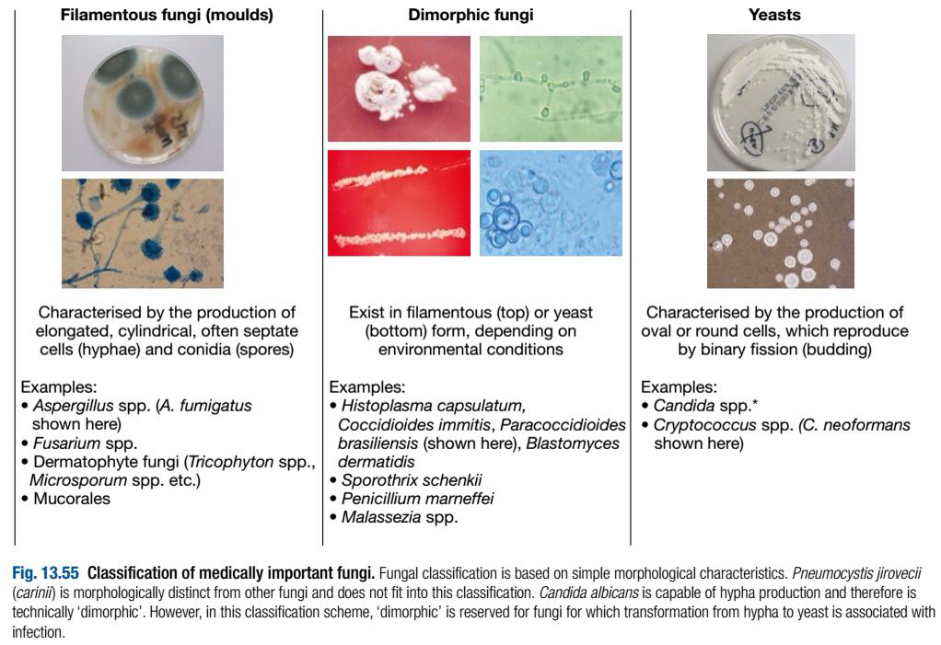

Slide 4
Superficial mycoses:
Candidiasis (thrush):
Superficial candidiasis is caused by Candida spp. yeasts (mainly C. albicans).
Common disease manifestations include oropharyngeal and vaginal candidiasis (‘thrush’), intertrigo and chronic paronychia.
Oral and vaginal thrush often follow treatment with broad-spectrum antibiotics.

Slide 5
Intertrigo is characterised by inflammation in skin folds with surrounding ‘satellite lesions’.
Chronic paronychia is associated with occupations involving frequent wetting of the hands.
Treatment of superficial candidiasis is mainly with topical antifungal azoles, with oral azoles reserved for refractory or recurrent disease (mainly thrush).

Slide 6
Severe oropharyngeal and oesophageal candidiasis is a consequence of CD4+ T lymphocyte depletion/dysfunction, as in HIV infection, and recurrent vaginal or penile candidiasis may be an early manifestation of diabetes mellitus.

Slide 7
Subcutaneous mycoses:
Chromoblastomycosis:
Chromoblastomycosis is a predominantly tropical or subtropical fungal disease caused by environmental dematiaceous (dark-pigmented) fungi, most commonly Fonsecaea pedrosoi.
Other causes include F. compacta, Cladophialophora carrionii and Phialophora verrucosa.

Slide 8
The disease is a cutaneous/subcutaneous mycosis acquired by traumatic inoculation. Consequently, the most commonly affected areas are the foot, ankle and lower leg.
Lesions may start several months after the initial injury, and medical attention is often sought several years later.
The initial lesion is a papule. Further papules develop, and coalesce to form irregular plaques.
Nodular lesions may produce a characteristic ‘cauliflower’ appearance.

Slide 9
Diagnosis is by histopathological examination of infected material, which shows dematiaceous, rounded, thick-walled ‘sclerotic bodies’ with septa at right angles to each other.
The aetiological agent is confirmed by culture.

Slide 10
Many therapeutic approaches have been explored, including antifungal agents, cryosurgery and surgical excision, alone or in combination, but the optimal therapy is unknown.

Slide 11
Of the antifungal agents, itraconazole and terbinafine are considered to be the most effective. However, posaconazole has also been used with a good outcome.

Slide 12
Mycetoma:
Mycetoma is a chronic suppurative infection of the deep soft tissues and bones, most commonly of the limbs but also of the abdominal or chest wall or head.
It is caused by either aerobic or anaerobic branching Gram-positive bacilli, Actinomycetales (actinomycetoma—60%), or by true fungi, Eumycetes (eumycetoma—40%).

Slide 13
Many fungi cause eumycetomas, the most common being Madurella mycetomatis, M. grisea, Leptosphaera senegalensis and Scedosporium apiospermum.
Actinomycetomas are caused by Actinomadura, Nocardia and Streptomyces spp.

Slide 14
Both groups produce characteristically coloured grains, the colour depending on the organism (black grains—eumycetoma, red and yellow grains—actinomycetoma, white grains—either).
The disease occurs mostly in the tropics and subtropics.

Slide 15
Clinical features:
The disease is acquired by inoculation (e.g. from a thorn) and most commonly affects the foot (Madura foot).
The mycetoma begins as a painless swelling at the site of implantation, which grows and spreads steadily within the soft tissues, causing further swelling and eventually penetrating bones.

Slide 16
Nodules develop under the epidermis and these rupture, revealing sinuses through which grains (Actinomycete / fungal colonies) may be discharged.
Some sinuses may heal with scarring while fresh sinuses appear elsewhere.

Slide 17
Deeper tissue invasion and involvement of bone are rapid and greater in actinomycetoma than eumycetoma.
There is little pain and usually no fever or lymphadenopathy, but there is progressive disability.

Slide 18
Investigations:
Diagnosis is confirmed by demonstration of fungal grains in pus, and/or histopathological examination of tissue.
Culture is necessary for species identification and (for actinomycetoma) susceptibility testing.
Serological tests are not available.

Slide 19
Management:
Eumycetoma is generally treated with surgery plus antifungal therapy, and actinomycetoma with antibacterial therapy alone.

Slide 20
Antifungal therapy for eumycetoma depends on the specific fungus isolated.
Itraconazole and ketoconazole (both 200–400 mg/day) are used commonly, and success has also been reported with voriconazole and posaconazole.
Therapy is continued for 6–12 months.
In extreme cases amputation may be required.

Slide 21
In general actinomycetoma is treated with co- trimoxazole for several months.
Disease caused by Nocardia spp. is treated with dapsone plus co-trimoxazole.
In extensive disease amikacin or netilmicin may be added.
Other agents, including minocycline, co-amoxiclav, streptomycin, imipenem and rifampicin, have been used successfully.

Slide 22
Phaeohyphomycosis:
Phaeohyphomycosis is a heterogenous group of fungal diseases caused by a large number (> 70) of dematiaceous fungi.
In phaeohyphomycosis the tissue form of the fungus is predominantly mycelial (filamentous), as opposed to eumycetoma (grain) or chromoblastomycosis (sclerotic body).

Slide 23
Disease may be superficial, subcutaneous or deep.
The most serious manifestation is cerebral phaeohyphomycosis, which presents with a ring-enhancing, space-occupying cerebral lesion.

Slide 24
Optimal therapy for this condition has not been established, but treatment usually consists of neurosurgical intervention and antifungal (usually triazole) therapy.

Slide 25
Causative agents are Cladophialophora bantiana, Fonsecaea spp. and Rhinocladiella (formerly Ramichloridium) mackenziei, which occurs in the Middle East and is usually fatal.

Slide 26
Sporotrichosis:
Sporotrichosis is caused by Sporothrix schenckii, a dimorphic fungal saprophyte of plants in tropical and subtropical regions.
Disease is caused by accidental dermal inoculation of the fungus, usually from a thorn (occasionally from a cat scratch).

Slide 27
In fixed cutaneous sporotrichosis a subcutaneous nodule develops at the site of infection and subsequently ulcerates, with a purulent discharge.
The disease may then spread along the cutaneous lymphatic channels, resulting in multiple cutaneous nodules along their route, which ulcerate and discharge (lymphocutaneous sporotrichosis).

Slide 28
Rarer forms of disease are seen, for example, in patients with cutaneous disease presenting with arthritis. Later, draining sinuses may form.

Slide 29
Pulmonary sporotrichosis occurs as a result of inhalation of the conidia and manifests itself as chronic cavitary fibronodular disease with haemoptysis and constitutional symptoms.
Disseminated disease may occur, especially in patients with HIV.

Slide 30
Investigations:
Typical yeast forms detected on histology of the biopsy confirm the diagnosis but are rarely seen; the fungus can be grown from the specimen in culture.
A latex agglutination test is available to detect S. schenkii antibodies in serum.

Slide 31
Management:
Cutaneous and lymphocutaneous disease is treated with oral itraconazole (200–400 mg daily, best absorbed as the oral solution formulation) for 3–6 months.

Slide 32
Alternative agents include a saturated solution of potassium iodide (SSKI, given orally), initiated with 5 drops and increased to 40–50 drops 8-hourly, or terbinafine (500 mg 12-hourly).
Localised hyperthermia may be used in pregnancy (to avoid azole use).

Slide 33
Osteoarticular disease requires a longer course of therapy (≥ 12 months).
Severe or life-threatening disease is treated with amphotericin B (lipid formulation preferred).

Slide 34
Systemic mycoses:
Aspergillosis:
Aspergillosis is an opportunistic systemic mycosis, which affects predominantly the respiratory tract.

Slide 35
Candidiasis:
Systemic candidiasis is an opportunistic mycosis caused by Candida spp.
The most common cause is C. albicans.
Other agents include C. dubliniensis, C. glabrata, C. krusei, C. parapsilosis and C. tropicalis.
Species distribution varies geographically.

Slide 36
Candida species identification often enables prediction of susceptibility to fluconazole; C. krusei is universally resistant, many C. glabrata isolates are either ‘susceptible-dose dependent’ (S-DD) or resistant, and other species are mostly susceptible.

Slide 37
Candidiasis is usually an endogenous disease that originates from oropharyngeal, genitourinary or skin colonisation, although nosocomial spread has been reported.

Slide 38
Syndromes of systemic candidiasis:
a. Acute disseminated candidiasis:
This usually presents as candidaemia (isolation of Candida spp. from the blood).
The main predisposing factor is the presence of a central venous catheter.

Slide 39
Other major factors include recent abdominal surgery, total parenteral nutrition (TPN), recent antibiotic therapy and localised Candida colonisation.
Up to 40% of cases will have ophthalmic involvement, with characteristic retinal ‘cotton wool’ exudates.

Slide 40
As this is a sight-threatening condition, candidaemic patients should be assessed by detailed ophthalmoscopy.
Skin lesions (non-tender pink/red nodules) may be seen.

Slide 41
Although predominantly a disease of intensive care and surgical patients, acute disseminated candidiasis and/or Candida endophthalmitis is seen occasionally in injection drug-users, thought to be due to candidal contamination of citric acid or lemon juice used to dissolve heroin.

Slide 42
b. Chronic disseminated candidiasis (CDC, hepatosplenic candidiasis):
In this condition a neutropenic patient has a persistent fever despite antibacterial therapy.
The fever persists despite neutrophil recovery, and is associated with the development of abdominal pain, raised alkaline phosphatase and multiple lesions in abdominal organs (e.g. liver, spleen and/or kidneys) on radiological imaging.
CDC may represent an immune reconstitution inflammatory syndrome (IRIS), and usually lasts for several months despite appropriate therapy.

Slide 43
Other manifestations:
Renal tract candidiasis, osteomyelitis, septic arthritis, peritonitis, meningitis and endocarditis are all well recognised, and are usually sequelae of acute disseminated disease.
Diagnosis and treatment of these conditions require specialist mycological advice.

Slide 44
Management:
Blood cultures positive for Candida spp. must never be ignored.
Acute disseminated candidiasis is treated with antifungal therapy, removal of any in-dwelling central venous catheter (whether known to be the source of infection or not) and removal of any known source.

Slide 45
Initial therapy is usually with fluconazole, unless the patient has recently received this agent, is known to be colonised with a resistant Candida strain, or is considered to be unstable (i.e. exhibiting signs of sepsis); in this case, an echinocandin is preferred.

Slide 46
Therapy is adjusted according to clinical response, species involved and susceptibility testing, and continues for at least 14 days.
Other appropriate therapies include voriconazole and amphotericin B formulations.

Slide 47
CDC is treated with fluconazole or other agents, depending on species and clinical response, and is prolonged (several months).
There is some evidence that duration may be reduced by adjuvant therapy with systemic corticosteroids.

Slide 48
Cryptococcosis:
Cryptococcosis is an opportunistic systemic mycosis caused by two environmental yeast species, Cr. neoformans and Cr. gattii.
Cr. neoformans is distributed worldwide and causes opportunistic disease associated with many immunosuppressed states, predominantly HIV infection.
Cr. gattii is a primary pathogen, mainly of the tropics and subtropics.

Slide 49
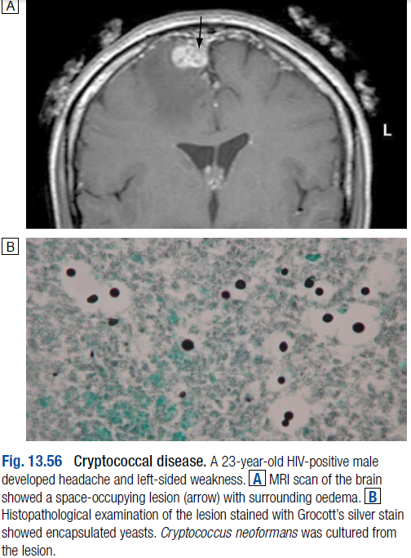
Although the disease is acquired by inhalation of yeasts, isolated pulmonary disease is rare.
The fungus may disseminate to any organ, most commonly the CNS (cryptococcal meningitis/cryptococcoma) and skin.

Slide 50
Cryptococcal meningitis is characterised by an indolent presentation with headache and visual loss. CSF is predominantly lymphocytic, although there may be few or no white blood cells, and frequently an elevated opening pressure.

Slide 51
Diagnosis is by direct detection or culture.
Microscopy of infected specimens shows encapsulated yeasts (India ink test); cryptococcal antigen (capsular polysaccharide) may be detected in blood and/or CSF; or the organism may be cultured from blood, CSF or lesions (e.g. skin nodules, bone).
Serological testing (i.e. antibody detection) is not appropriate.

Slide 52
Antifungal treatment of cryptococcal meningitis consists of induction therapy with intravenous amphotericin B (lipid formulation if available) and oral 5-flucytosine (5-FC), followed by consolidation therapy with an azole (usually fluconazole).

Slide 53
Therapy with fluconazole is continued for as long as the patient has significant immunosuppression.
If CSF pressure is elevated, regular lumbar drainage may be used to prevent features of raised intracranial pressure.
Monitoring of recovery by changes in antigen titre is unreliable, and is not recommended.

Slide 54
Fusariosis:
Fusarium spp. cause disseminated disease in patients with profound or prolonged neutropenia.
The disease presents with antibiotic-resistant fever and evidence of dissemination (e.g. skin nodules, endophthalmitis, septic arthritis, pulmonary disease).

Slide 55
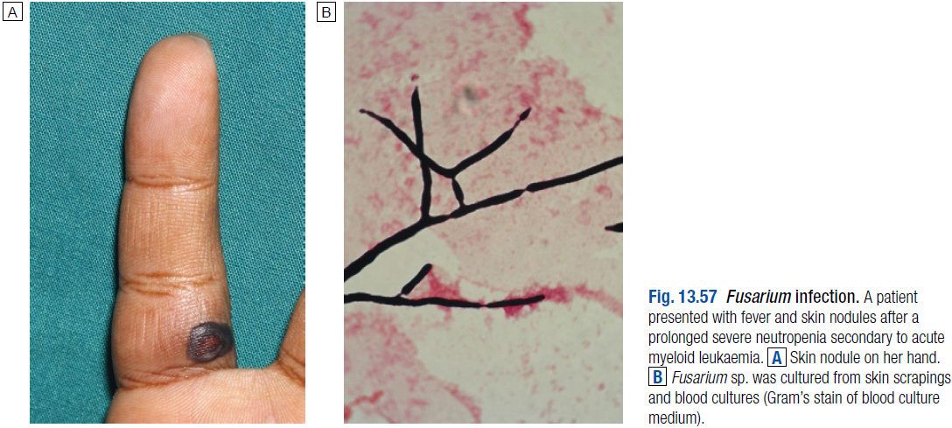

Slide 56
In contrast to Aspergillus spp., Fusarium spp. is often recovered from blood cultures.
Treatment is challenging, because of resistance to several antifungal agents.
Voriconazole, posaconazole and lipid-formulated amphotericin B are the most commonly used antifungal agents.

Slide 57
Mucormycosis:
Mucormycosis is a severe but uncommon opportunistic systemic mycosis caused by any of the Mucorales, mainly Myocladus (formerly Absidia) spp., Rhizomucor spp., Mucor spp. and Rhizopus spp.

Slide 58
Disease patterns include rhinocerebral/craniofacial, pulmonary, cutaneous and systemic disease.
All are characterized by the rapid development of severe tissue necrosis, which is almost always fatal if left untreated.

Slide 59
The major predisposing factors are uncontrolled diabetes mellitus, iron chelation therapy with desferrioxamine, severe burns and, most commonly, profound immunosuppression from neutropenia or bone marrow transplant in association with the use of broad-spectrum azole prophylaxis with agents like voriconazole.

Slide 60
Diagnosis is by culture, but histopathological confirmation is required as the fungi may be environmental contaminants.

Slide 61
Treatment requires a combination of antifungal therapy and surgical débridement, with correction of predisposing factor(s) if possible.
High-dose lipid-formulated amphotericin B is used most commonly, although posaconazole is active in vitro and has been used successfully.

Slide 62
Penicillium marneffei infection:
P. marneffei is a thermally dimorphic pathogen (filamentous in environmental conditions and yeast at body temperature), which causes disease in South-east Asia, mainly in association with HIV infection (although immunocompetent patients may also be infected).

Slide 63
Acquisition is most likely to be by inhalation of environmental spores, with primary lung infection followed by haematogenous dissemination.
A generalised papular rash, which progresses to widespread necrosis and ulceration, is a characteristic feature.
Skin lesions may resemble those of molluscum contagiosum.

Slide 64
Diagnosis is by histopathology and/or culture of respiratory secretions, blood or any infected clinical material (e.g. skin lesions, bone marrow, biopsies).
Recommended treatment is with an amphotericin B formulation (in severe infection), followed by itraconazole.

Slide 65
Histoplasmosis:
Histoplasmosis is a primary systemic mycosis caused by Histoplasma capsulatum, a dimorphic fungus.
H. capsulatum is considered to consist of two variants, var. capsulatum and var. duboisii.

Slide 66
H. capsulatum var. capsulatum is endemic to the Mississippi and Ohio river valleys and found throughout east-central USA.
Less commonly, it is found in Latin America from Mexico to Argentina, Europe, Africa, India, Malaysia, Indonesia and Australia.

Slide 67
H. capsulatum var. duboisii is found mainly in tropical parts of West Africa and Madagascar.
The taxonomic status of H. capsulatum is subject to ongoing re-evaluation.

Slide 68
Habitat:
The primary reservoir of H. capsulatum is soil enriched by bird and bat droppings, in which the fungus remains viable for many years.
Infection is by inhalation of dust from such soil.
Natural infections are found in bats, which represent a secondary reservoir of infection (via bat faeces).
Histoplasmosis is a specific hazard for explorers of caves and people who clear out bird (including chicken) roosts.

Slide 69
Pathology:
The organism is inhaled in the form of conidia (spores) or hyphal fragments and transforms to the yeast phase during infection.
Conidia or yeasts are phagocytosed by alveolar macrophages and neutrophils, and this may be followed by haematogenous dissemination to any organ.
Subsequent development of a T-lymphocyte response brings the infection under control, resulting in a latent state in most exposed individuals.

Slide 70
Clinical features:
Disease severity depends on the quantity of spores inhaled and the immune status of the host.
In most cases infection is asymptomatic.
Pulmonary symptoms are the most common disease presentation, with fever, non-productive cough and an influenza-like illness.
Erythema nodosum, myalgia and joint pain are common, and chest radiography may reveal a pneumonitis with hilar or mediastinal lymphadenopathy.

Slide 71
Patients with pre-existing lung disease, such as chronic obstructive pulmonary disease (COPD) or emphysema, may develop chronic pulmonary histoplasmosis.
The predominant features of this condition, which may easily be mistaken for tuberculosis, are fever, cough, dyspnoea, weight loss and night sweats.
Radiological findings include fibrosis, nodules, cavitation and hilar/mediastinal lymphadenopathy.

Slide 72
Disease caused by H. capsulatum var. duboisii presents more commonly with papulonodular and ulcerating lesions of the skin and underlying subcutaneous tissue and bone (sometimes referred to as ‘African histoplasmosis’).
Multiple lesions of the ribs are common and the bones of the limbs may be involved.
Lung involvement is relatively rare.
Radiological examination may show rounded foci of bone destruction, sometimes associated with abscess formation.
Other disease patterns include a visceral form with liver and splenic invasion, and disseminated disease.

Slide 73
Acute disseminated histoplasmosis is seen in association with immunocompromise, including HIV infection. Features include fever, pancytopenia, hepatosplenomegaly, lymphadenopathy and often a papular skin eruption.
Chronic disseminated disease presents with fever, anorexia and weight loss. Cutaneous and mucosal lesions, lymphadenopathy, hepatosplenomegaly and meningitis may also develop.

Slide 74
Investigations:
In areas where the disease occurs, histoplasmosis should be suspected in every undiagnosed infection in which there are pulmonary signs, enlarged lymph nodes, hepatosplenomegaly or characteristic cutaneous/bony lesions.

Slide 75
Radiological examination in long-standing cases may show calcified lesions in the lungs, spleen or other organs.
In the more acute phases of the disease, single or multiple soft pulmonary shadows with enlarged tracheobronchial nodes are seen on chest X-ray.

Slide 76
Laboratory diagnosis is by direct detection (histopathology or antigen detection), culture and serology, with antigen and antibody detection being most effective (antigen detection, however, is not widely available).

Slide 77
Antibody is detected by complement fixation testing or immunodiffusion; the pattern of antibody production is complex, and the results require specialist interpretation.
Histoplasma antigen may be detectable in blood or urine.
Culture is definitive but slow (up to 12 weeks).
Histopathology may show characteristic intracellular yeasts.
Diagnosis of subcutaneous or bony infection is mainly by histopathological examination and/or culture.

Slide 78
Management:
Mild pulmonary disease does not require treatment. However, if prolonged, it may be treated with itraconazole.
More severe pulmonary disease is treated with an amphotericin B formulation for 2 weeks, followed by itraconazole for 12 weeks, with methylprednisolone added for the first 2 weeks of therapy if there is hypoxia or ARDS.

Slide 79
Chronic pulmonary histoplasmosis is treated with itraconazole (ideally the oral solution, which has better bio-availability than the capsule formulation) for 12–24 months, and disseminated histoplasmosis with an amphotericin B formulation followed by itraconazole.
Lipid formulations of amphotericin B are preferred, but their use is subject to availability.

Slide 80
Treatment should be guided by current evidence-based guidelines (e.g. Infectious Diseases Society of America practice guidelines).
In subcutaneous and bone infection patterns of remission and relapse are more common than cure. A solitary bony lesion may require only local surgical treatment.

Slide 81
Coccidioidomycosis:
This is a primary systemic mycosis caused by the dimorphic fungi Coccidioides immitis and C. posadasii, found in the south-western USA, and Central and South America.
The disease is acquired by inhalation of conidia (arthrospores).

Slide 82
In 60% of cases it is asymptomatic, but in the remainder it affects the lungs, lymph nodes and skin.
Rarely (approx. 0.5%), it may spread haematogenously to bones, adrenals, meninges and other organs.

Slide 83
Pulmonary coccidioidomycosis has two forms: primary and progressive.
If symptomatic, primary coccidioidomycosis presents with cough, fever, chest pain, dyspnoea and (commonly) arthritis and a rash (erythema multiforme).
Progressive disease presents with systemic upset (e.g. fever, weight loss, anorexia) and features of lobar pneumonia, and may resemble tuberculosis.

Slide 84
Coccidioides meningitis (which may be associated with CSF eosinophils) is the most severe disease manifestation, which is fatal if untreated, and requires life-long suppressive therapy with antifungal azoles.

Slide 85
Investigations and management:
Diagnosis is by direct detection (histopathological examination of infected tissue), culture of infected tissue or fluids, or antibody detection.
IgM may be detected after 1–3 weeks of disease by precipitin tests.
IgG appears later and is detected with the complement fixation test.
Change in IgG titre may be used to monitor clinical progress.

Slide 86
Treatment depends on specific disease manifestations, and ranges from regular clinical re-assessment without antifungal therapy (in mild pulmonary, asymptomatic cavitary or single nodular disease) to high-dose treatment with an antifungal azole, which may be continued indefinitely (e.g. in meningitis).
Amphotericin B is used in diffuse pneumonia, disseminated disease and, intrathecally, in meningitis.
Posaconazole has been used successfully in refractory disease.

Slide 87
Paracoccidioidomycosis:
This is a primary systemic mycosis caused by inhalation of the dimorphic fungus Paracoccidioides brasiliensis which is restricted to South America.
The disease affects the lungs, mucous membranes (painful destructive ulceration in 50% of cases), skin, lymph nodes and adrenal glands (hypoadrenalism).
Diagnosis is by microscopy and culture of lesions, and antibody detection.

Slide 88
Oral itraconazole solution 200 mg/day has demonstrated 98% efficacy, and is currently the treatment of choice (mean duration 6 months).
Ketoconazole, fluconazole and voriconazole have also been used, as have long (2–3-year) courses of sulphonamides.
Amphotericin B may be used in severe or refractory disease, followed by an azole or sulphonamide.

Slide 89
Blastomycosis:
Blastomyces dermatitidis is a dimorphic fungus endemic to restricted parts of North America, mainly around the Mississippi and Ohio rivers. Very occasionally, it is reported from Africa.
The disease usually presents as a chronic pneumonia similar to pulmonary tuberculosis.
Bones, skin and the genitourinary tract may also be affected.

Slide 90
Diagnosis is by culture of the organism or identification of the characteristic yeast form in a clinical specimen. Antibody detection is rarely helpful.
Treatment is with amphotericin B (severe disease) or itraconazole.

Slide 91
cENDd

